Slide 1
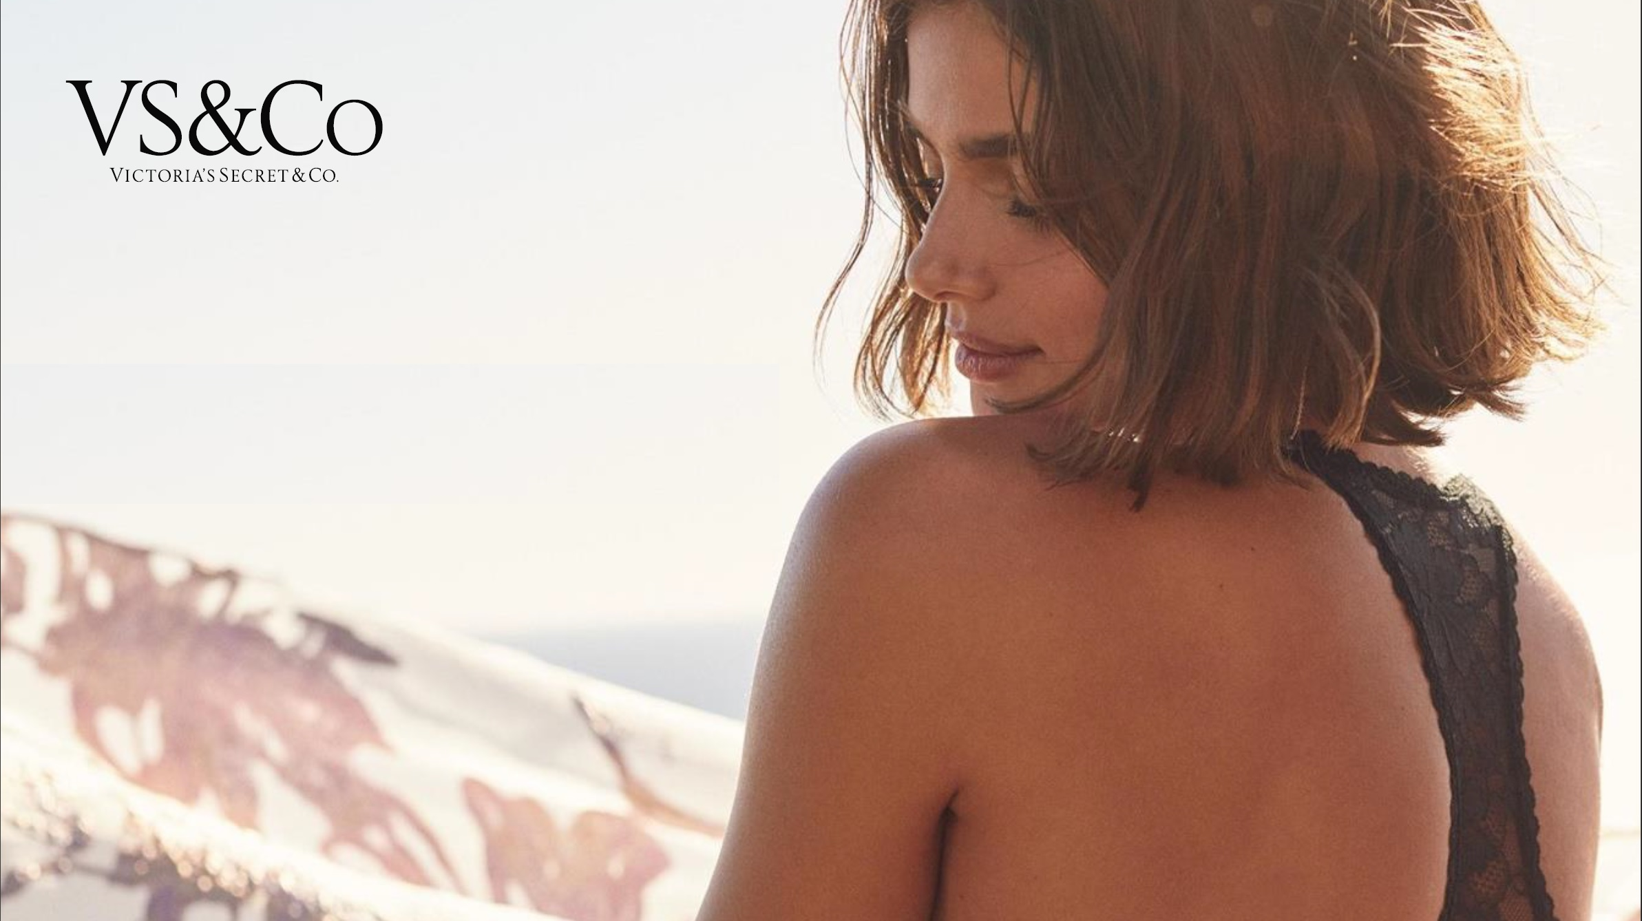
IMC Campaign 2022
Team 6
Laura Camacho Morales
Maryna Khatnyuk
Muhammad Ali Mirza
Notes:
Good morning everyone
We are team 6
We are going to present the IMC campaign of VS
In particular we are going to talk about the image problem that the company is facing and how our campaign will address that

Slide 2
Industry Overview
Industry Sales by Category
Market Share
Notes:
Starting with an overview of the industry, we can see the major segments in the industry
Going over to market share, we see that the industry that is characterized by a large number of competitors and low market shares. Victoria’s Secret is the market leader with a market share of slightly over 10%.

Slide 3
Company Overview
Specialty retailer of women’s intimates, apparels, and beauty products.
Offers a wide assortment of modern, fashion-inspired collections that provide superior quality, fit, function, and feminine feel.
Notes:
Now talking about the company itself and what it offers, VS is a specialty..
What’s makes the brand special is that it offers..
Coming to the company’s sales across different channels, 53% of..

Slide 4
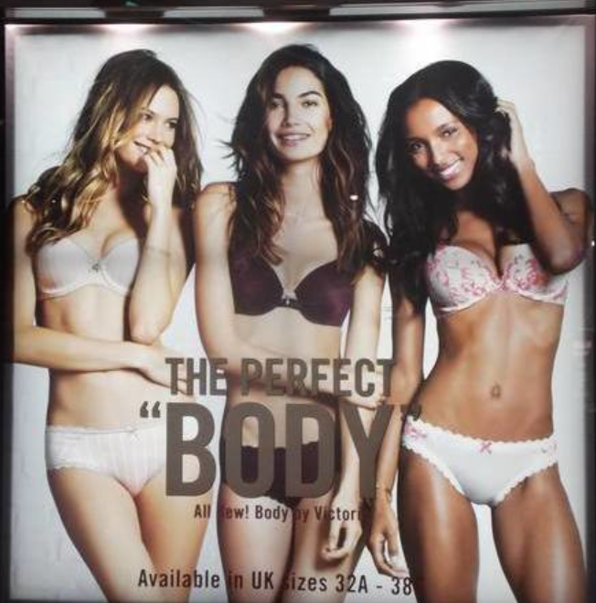
The Problem
Since 2016, market share has declined, from about 21% to 10.4%.
Most women feel that they are not represented by the brand.
The brand is perceived to be non-inclusive as it portrayed the ‘perfect body’ to be slender and skinny.
Following backlash for promoting an unhealthy and unrealistic body image for women, VS is attempting to reposition itself as a more inclusive retailer that caters to the needs of all women (different shapes, sizes and ethnicities).
The challenge for the company is to convince the target audience that it is genuinely reinventing itself as a brand that represents all women.
Image source: (change.org, n.d.)

Slide 5
Objectives and Desired Outcomes
Alter the current consumer perceptions and bad reputation associated with the old Victoria’s Secret
To reposition the brand as representative, diverse and inclusive
To achieve an awareness level of 75% for the new image
The target market should see VS as a brand that is the voice of all women
Depict a brand image that is perceived to be inclusive
To show an emotional association with the brand that inspires empowerment

Slide 6
Positioning Statement
“Victoria's Secret is a specialty retailer of women's intimates, apparels, and beauty products. The brand represents a wide assortment of fashion-inspired collections that provide superior quality, fit, function, and feminine feel to inspire, uplift, and empower every woman.”

Slide 7
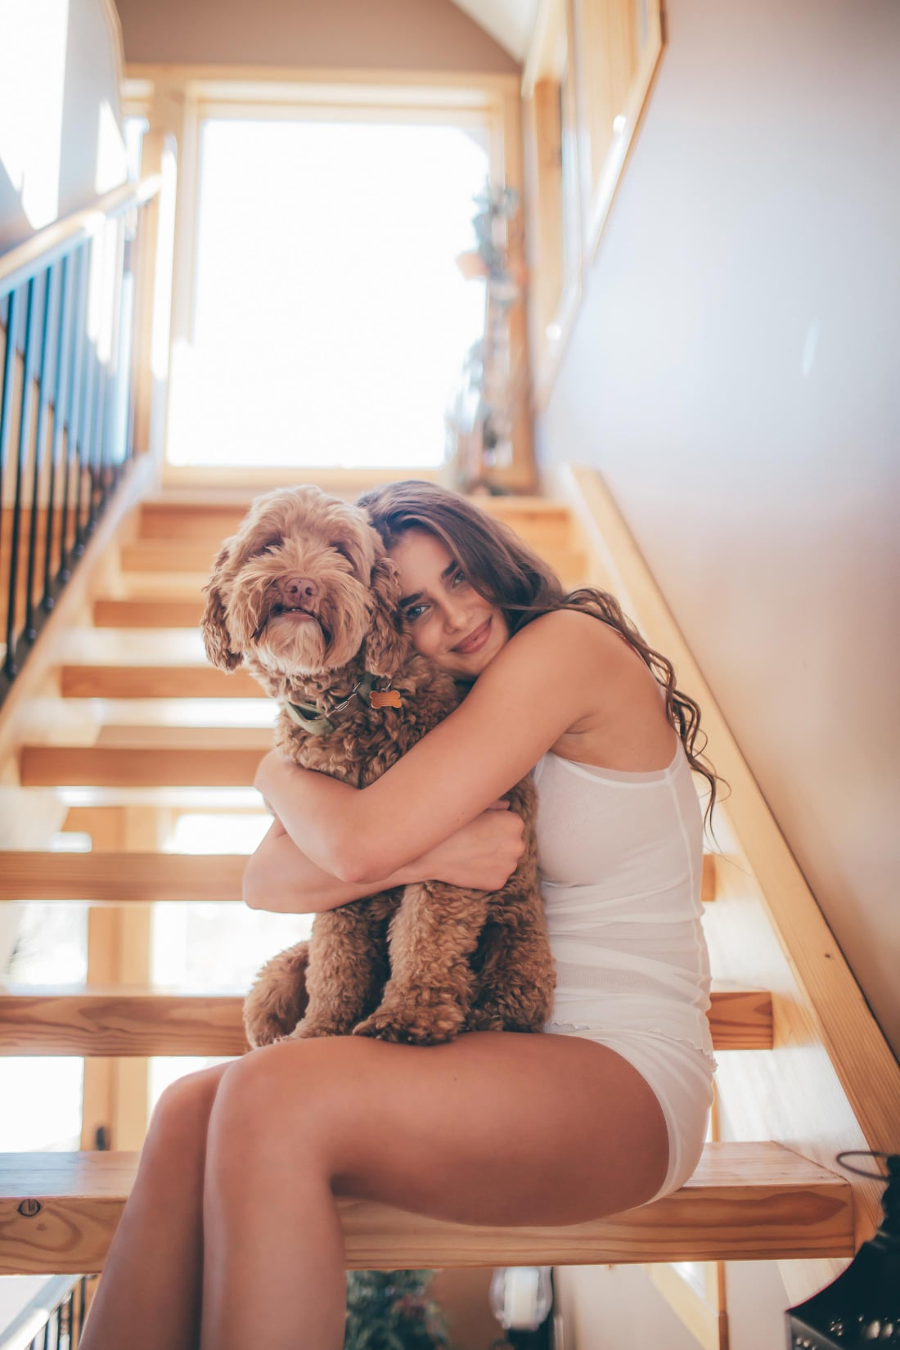
Creative Strategy
Central Theme
Inclusivity, inspiration, and empowerment.
Tone and style
The message will be presented in a vivacious manner.
Appeal Techniques
Positive and emotional appeals: Associate brand with positive feelings of happiness and empowerment.
Lifestyle appeal: Associate the brand with a modern, trendy lifestyle.
Image source: Victoria's Secret Facebook page, retrieved from https://www.facebook.com/VictoriasSecretCanada/photos/498786780751714

Slide 8
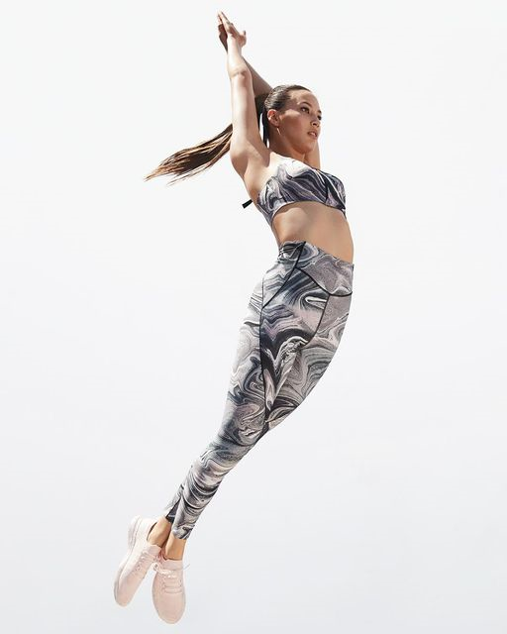
Media Objectives
WHO
WHAT
Primary target: women, age 16-60, urban markets.
Secondary target: men, age 22-70, urban markets.
Depict the brand as representative, diverse and inclusive.
WHERE
WHEN
Online and nationwide campaign prioritizing large urban centers.
The initial phase will receive more support. More engagement of primary target is expected outside of working hours. More emphasis will be placed on Holiday periods(Christmas and Valentine day) when targeting men.
HOW
Reach and frequency will be top priorities during the first phase. Continuity will take precedence in the second phase. Audience engagement will be vital for success.
Image source: Victoria's Secret Facebook page, retrieved from https://www.facebook.com/VictoriasSecretCanada/photos/a.338119896818404/838998420063880/

Slide 9
Media Strategy
Shotgun and profile matching strategy
Raise awareness and reach as many people as possible
Geographic focus will be national
Timing will be focused around people’s leisure time
Interactivity is a key factor of the entire campaign
The entire brand will carry the hashtag #WeAreVS
The goal is to start and maintain a conversation online regarding the campaign with the hashtag

Slide 10
Media Selection Rationale
Out-of-home (billboards, digital video boards and digital LED canvas walls)
Create mass awareness.
Reinforce message through daily exposure.
Remind customers when they are out shopping and making actual purchase decisions.
Print (fashion magazines)
Profile matching: Better targeting of the image-conscious customer.
Association with prestigious fashion magazines will help portray a top-of-the-line trendy brand image that will create desire and preference.

Slide 11
Media Selection Rationale
Online (display and video ads on third-party websites/apps, including social media)
Better targeting to have more impact.
Ease of online content sharing will enable content to go viral, enhancing reach and awareness in a cost-efficient manner.
Experiential (VS fashion show and in-store interactive mirrors)
The VS fashion show will engage the target market in a very personal way by having them represent the brand.
This will show the world the new image (inclusive) of VS and how it contrasts with the old image (exclusive).
The in-store interactive mirrors will feature light up angel wings that will enhance customer engagement and encourage store visits.
Note: TV advertising is not recommended due to high costs and waning popularity among the target market that prefers online mediums. TV offers lesser value for advertising dollars spent as compared to online alternatives.

Slide 12
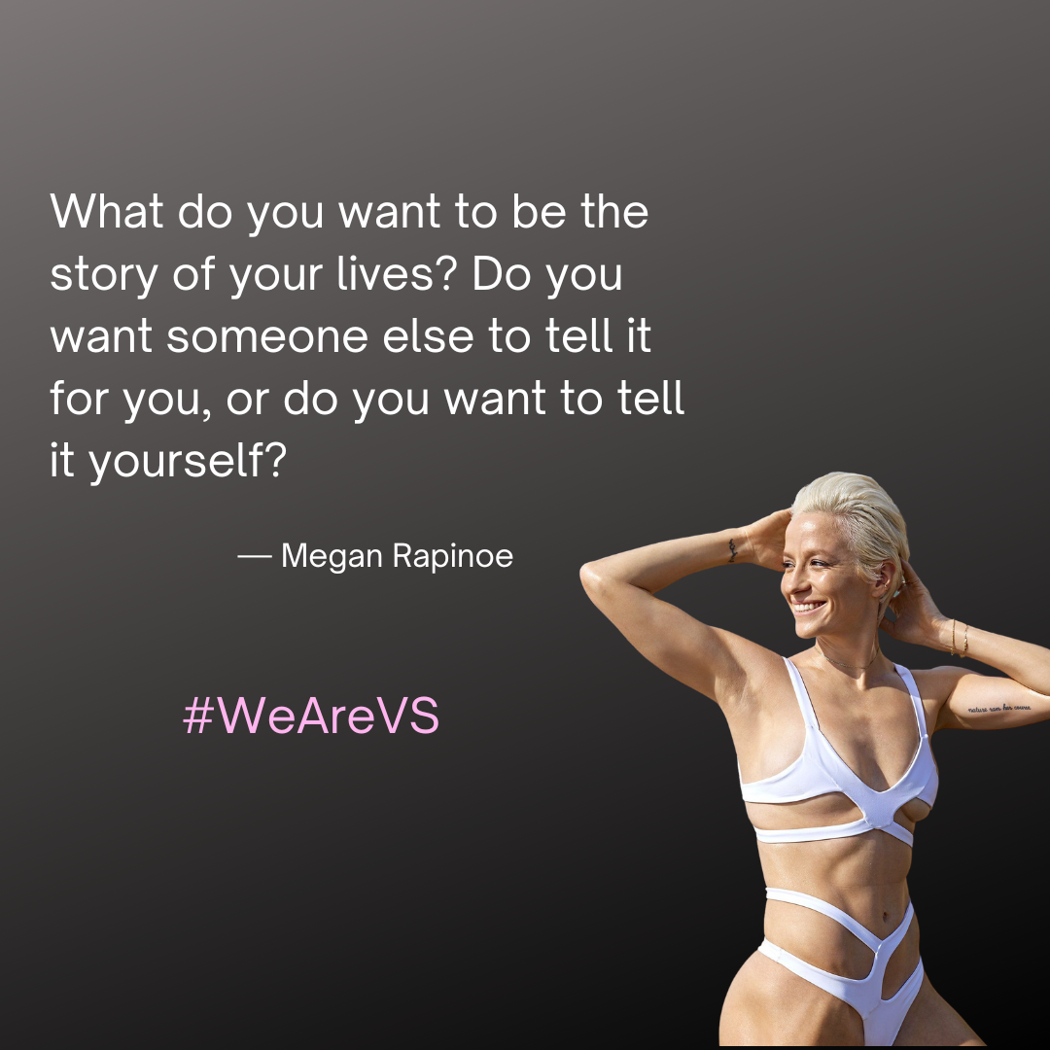
Media Execution
Out-of-Home
Media
Outdoor posters
Digital Billboards
LED Canvas Walls
Location
27 major urban markets of Canada.
The top five markets include Toronto/Mississauga/Hamilton, Vancouver, Edmonton, Calgary, and Montreal.
Creative
Positive emotional empowering messages from accomplished VS ambassadors to change brand perception.
Reinforcement of the magazines ads.
Advertising of in-store mirror and Fashion Show
Image source: Sports Illustrated, https://twitter.com/SI_Swimsuit/status/1246890415611150337?ref_src=twsrc%5Etfw

Slide 13
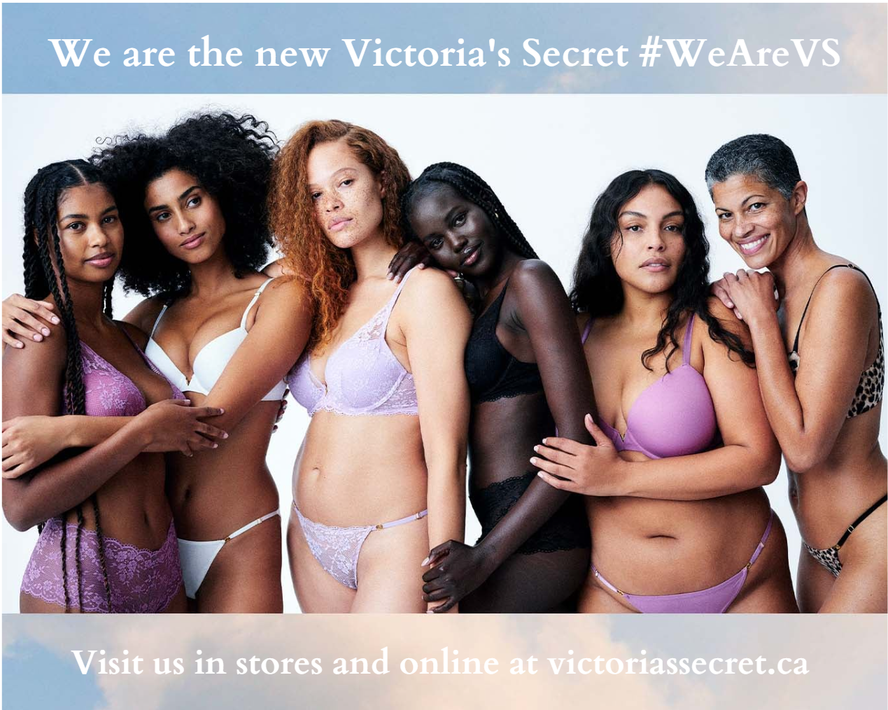
Media Execution
Print Magazines
The ad that shows diversity is designed to make the target audience curious and get them to visit our point-of-sale touchpoints.
Print ads will be featured in ‘Chatelaine’ and ‘Fashion’ magazines.
Chatelaine’s is a women’s magazine that has 69% women and 31% men readers.
Readers of Fashion magazine are 60% women and 40% men.
These magazines will reach both primary (women) and secondary (men) target markets in an appropriate proportion (more emphasis on reaching women).
Image source: (Victoria’s Secret & Co., n.d.)

Slide 14
Media Execution
Display and Video Ads
A mix of banner, rich media and video ads will be featured on Instagram, Facebook, and Youtube websites and apps. These social platforms are the most popular ones among all age groups in the target market.
Video storyboard and script
The ad will be short and sweet so that people are less likely to skip over as they are waiting for their video to start playing.
The ad will begin by showing the new Victoria’s Secret angels. It will feature women of different shapes, sizes and ethnicities.
There will be an upbeat pop song playing in the background for greater sensory engagement of the viewer.
One of the featured models will look straight into the camera and say “This is the new Victoria’s Secret” and end with a smile. The screen will fade to black and our hashtag, “WeAreVS”, will appear, followed by the message “visit us in stores and online at victoriassecret.ca”

Slide 15
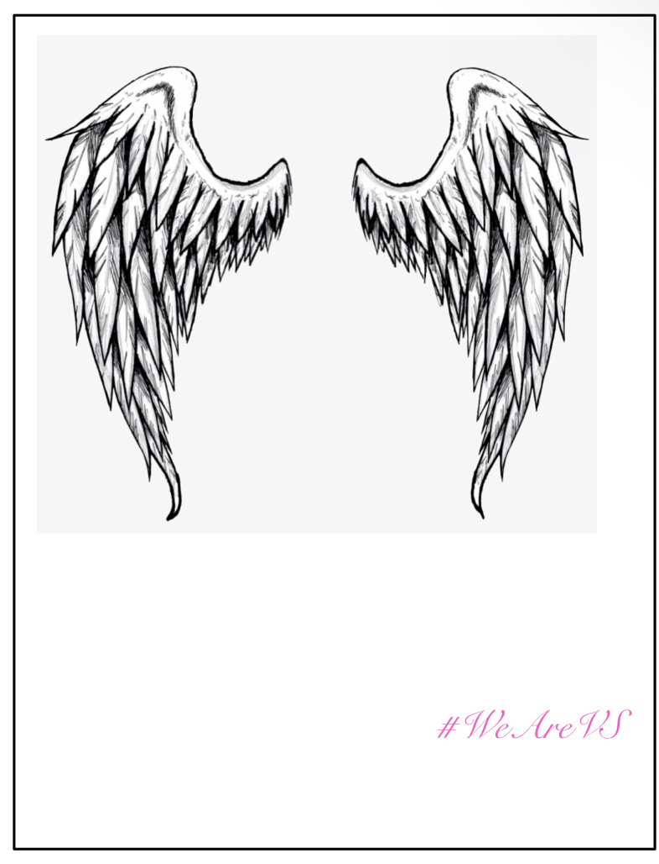
Media Execution
Interactive In Store Mirror
Featured at all the major retail malls such as Square One and Eaton Centre
The mirror will have the “angel wings” engraved into it
Shoppers will be able to take selfies with the wings to embrace that they are a VS angel as well
The hashtag will be placed at the bottom as well
The goal is for people to share their selfies online and spread awareness on the campaign

Slide 16
Media Execution
Tik Tok
Interactive platform
VS model will ask “Hey Tik Tok! I want you to show me your runaway walk”
The Tik Tok will end with our signature hashtag #WeAreVS
Users may recreate the trend, “stitch” it, share it or comment
They will be able to add their own personal twist
Will tie in with the main objective: Let people feel represented by the brand
VS Fashion Show
Will still feature the traits which made the past shows so iconic
This time women who represent every kind of woman will walk the runway - no more unrealistic beauty standards
Professional models will be featured
Open casting will also be held
Broadcasted on Youtube at 8 pm
People will be able to live react

Slide 17
The New vs Old
The Old
The New

Slide 18
Marketing Communication Calendar
Activity | Sep 2022 | Oct 2022 | Nov 2022 | Dec 2022 | Jan 2023 | Feb 2023
Print Magazines
Chatelaine
Fashion magazines
Out-of-Home
Outdoor posters in the top markets
Outdoor posters in other markets
Digital LED Canvas Board
Online and interactive communication
TikTok Trend
Display and video ads
Interactive in-store mirror
Fashion Show

Slide 19
Budget Allocation
Media Vehicle | Expenditure | % of total | Rationale
Outdoor | $ 1,500,000 | 30% | Second highest budget allocation as this media will be instrumental for creating awareness early on in the campaign.
Print magazines | $ 250,000 | 5% | Only 5% allocated because of declining popularity of this media.
Display and Video ads | $ 1,750,000 | 35% | Highest budget has been allocated to this as it is the most preferred media of the target market.
Fashion show | $ 1,000,000 | 20% | The show is key for engaging the target consumer and establishing the repositioned image in their minds. Therefore, a significant portion of the budget has been allocated for this purpose.
In-store mirrors | $ 250,000 | 5% | A small portion of the budget has been allocated for mirrors, which will be an economical yet effective tool for engaging the customer.
TikTok campaign | $ 250,000 | 5% | Starting TikTok trends does not require significant expenditure. So, a small portion of the budget has been allocated to this media.
Total | $ 5,000,000 | 100%

Slide 20
References
Change.org (n.d.). Apologise for, and amend the irresponsible marketing of your new bra range 'Body’. https://www.change.org/p/victoriassecret-apologise-for-your-damaging-perfect-body-campaign-iamperfect
Channel, T. L. (2021, Feb 13). Victoria's Secret Fashion Show 2021. Retrieved from Youtube: https://www.youtube.com/watch?v=CqQEis1thts
Victoria’s Secret & Co. (n.d.). Retrieved on June 24, 2022. https://www.victoriassecretandco.com/
Victoria's Secret . (2022, June 28th). Think You Know Us? Retrieved from Youtube: https://www.youtube.com/watch?v=2PAO--FaPss

